Slide 1

Valuation and Forecasting Model for Residential Properties
Ujjawal Dwivedi
Capstone Presentation
Supervised by : Dr Amir Jafari

Slide 2
Agenda
The Disconnect in Spatiotemporal Valuation
Component I: Micro-Valuation (LME)
Component II: Macro-Forecasting
Robust Evaluation & Key Results
Business Impact & Blueprint

Slide 3
The current real estate valuation systems are fragmented, failing to simultaneously integrate Macro-level market momentum with Micro-level local property desirability. This gap leads to inaccurate pricing and undefined risk ranges for institutional investors.

Slide 4
A Two Component Framework
Market Engine:
Predicts the future market trajectory and risk
Addresses market fragmentation and lacks of risk quantification.
Property Engine :
Calculates individual property's intrinsic and latent value.
Addresses inadequate neighborhood adjustments and spatial fragmentation.

Slide 5
Market Engine
Probabilistic ZIP-level price forecasts (1–2 months ahead)
We build a ZIP×month price index and train a multi-task tabular neural network that forecasts the distribution of future price moves, not just a single point estimate.
Log-return targets (what we forecast):
Rz,t(h)​=log(1+Pz,t(h)​)−log(1+Pz,t​),h∈{1,2}
Where: Pz,t(1)=Pz,t+1Pz,t(1)​=Pz,t+1​ and Pz,t(2)=Pz,t+2Pz,t(2)​=Pz,t+2
Model mapping (what the network does):
fθ​(xz,t​)→{Q^​τ(1)​(z,t),Q^​τ(2)​(z,t)}τ∈{0.1,0.5,0.9}​
Hierarchical pooled index :
Pz,t​=coalesce(Pz,traw​,Pc(z),tcty​,Ps(z),tst​)

Slide 6
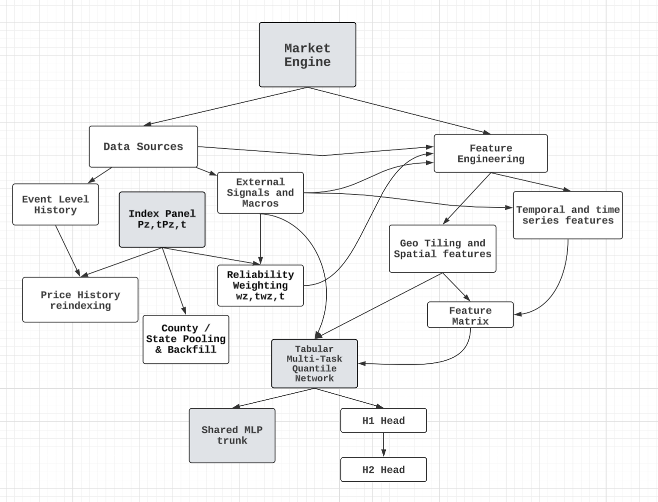
Structural Design of Market Engine
It is a multi-dependant system interconnecting various modules which can be seen in the codebase.

Slide 7
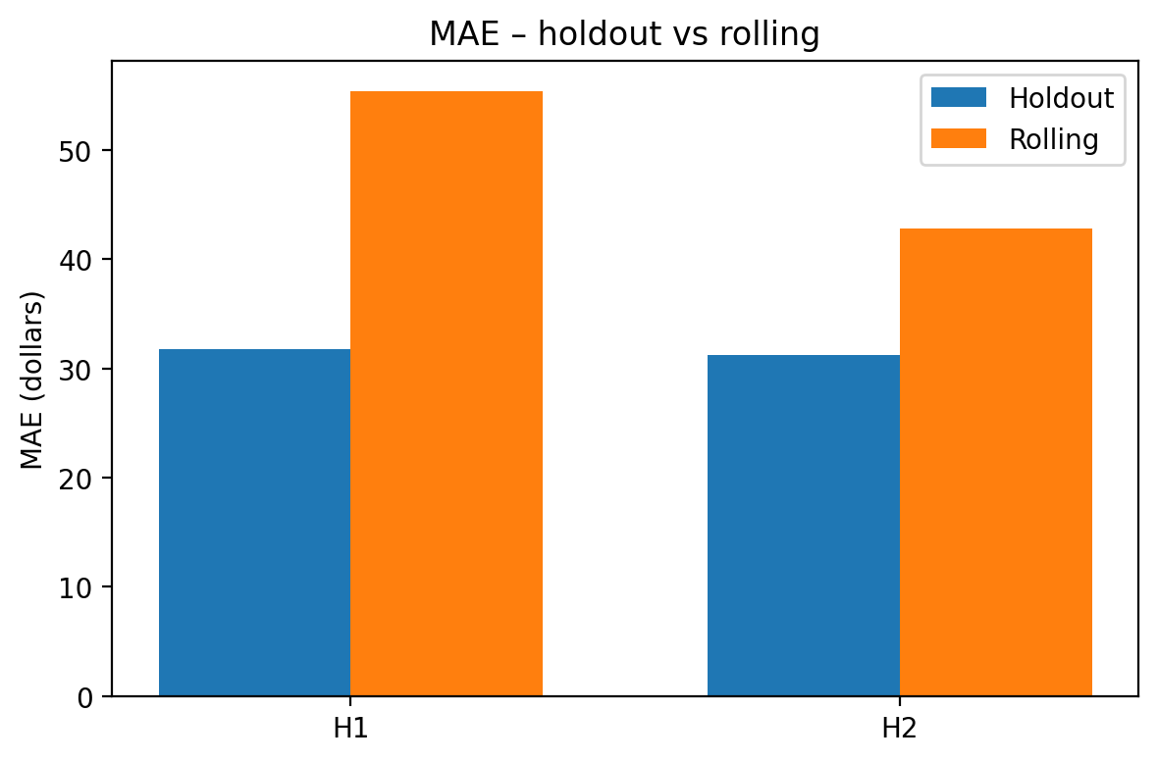
“Supporting information and evidence”
1
Low error on holdout : MAE is ≈ $31–32 for both 1-month (H1) and 2-month (H2) horizons.
Stress-tested over time: In rolling windows that span different market regimes, MAE stays in the $40–55 range, showing the model doesn’t break when the market shifts.
Actionable accuracy: Errors of ~$30–40 at the ZIP×month level are small relative to median home prices, making these forecasts usable for pricing, budgeting, and risk planning.

Slide 8
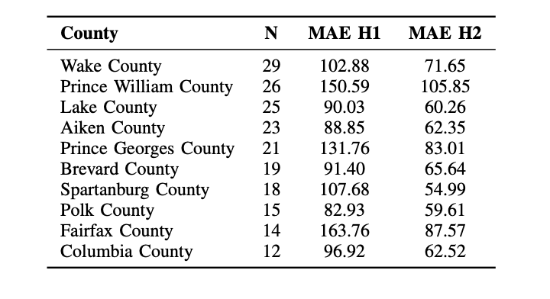
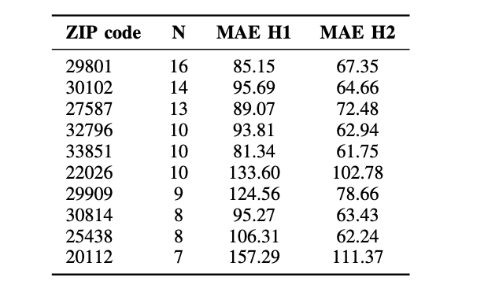
Applying the Market Engine to a New Dataset: County & ZIP Results
Inference of our market engine on a separate builder dataset, with accuracy reported at county and ZIP level.

Slide 9
Property Engine: Latent Manifold Estimation
Decomposes each home’s log price into:
Intrinsic value from tabular attributes (beds, baths, sqft, year built, etc.)
A smooth neighborhood desirability field over latitude/longitude.
Mimics how an appraiser works: start with structure-driven value, then adjust up/down for the micro-location.
Provides house-specific premiums/discounts relative to the local market and the ZIP forecast from the Market Engine.
Core Equation & Geometry
Modelling each home :

Slide 10
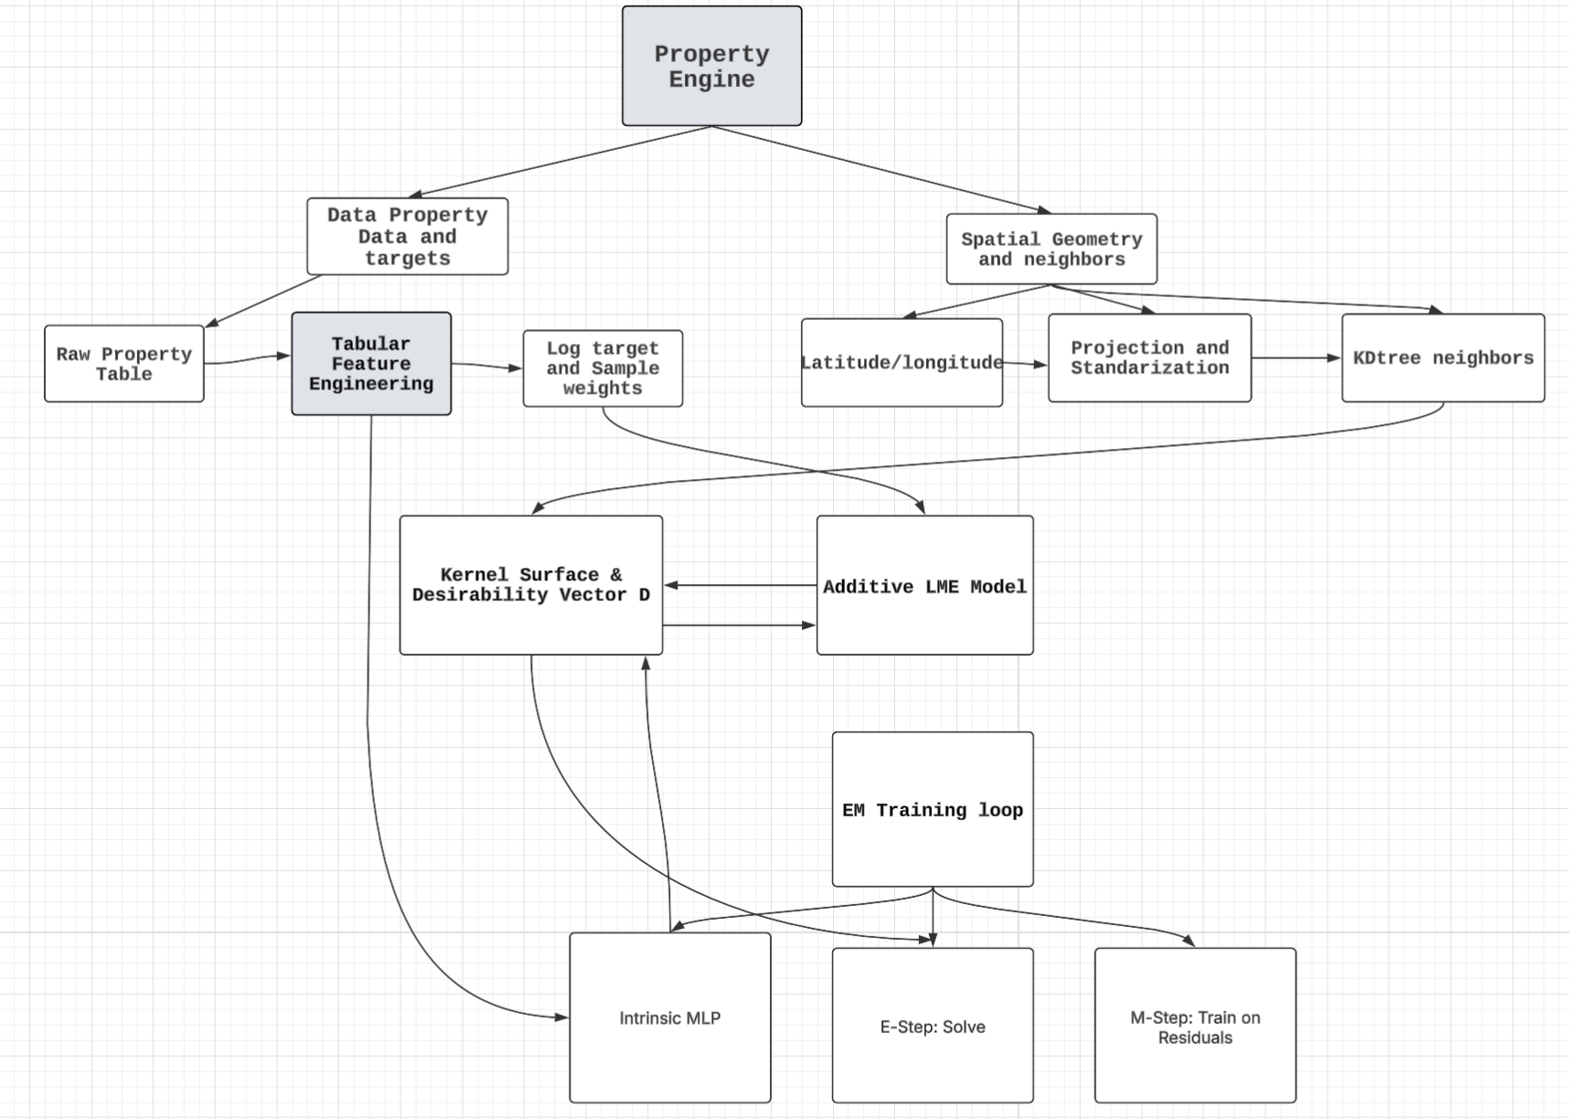
Structural Design of Property Engine
It is a multi-dependant system interconnecting various modules which can be seen in the codebase.

Slide 11
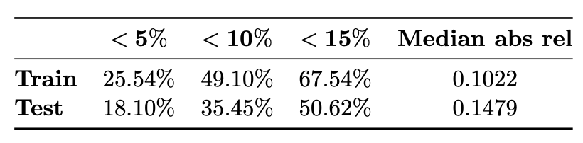
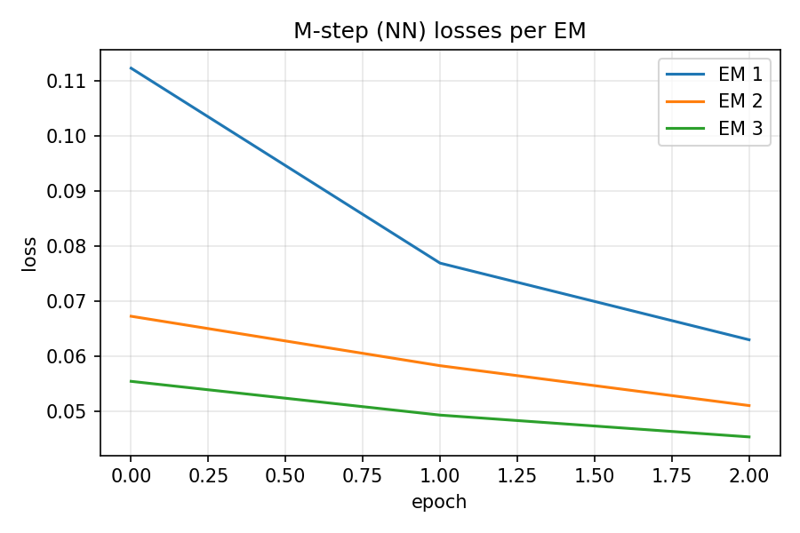
“Supporting information and evidence”
Current implementation accuracy: On our spatial test split,
18.1% of homes are within 5% price error,
35.45% within 10%,
50.62% within 15%, with median AbsRel ≈ 0.148. The corresponding train metrics are 25.54%, 49.10%, 67.54% and median AbsRel 0.1022.

Slide 12
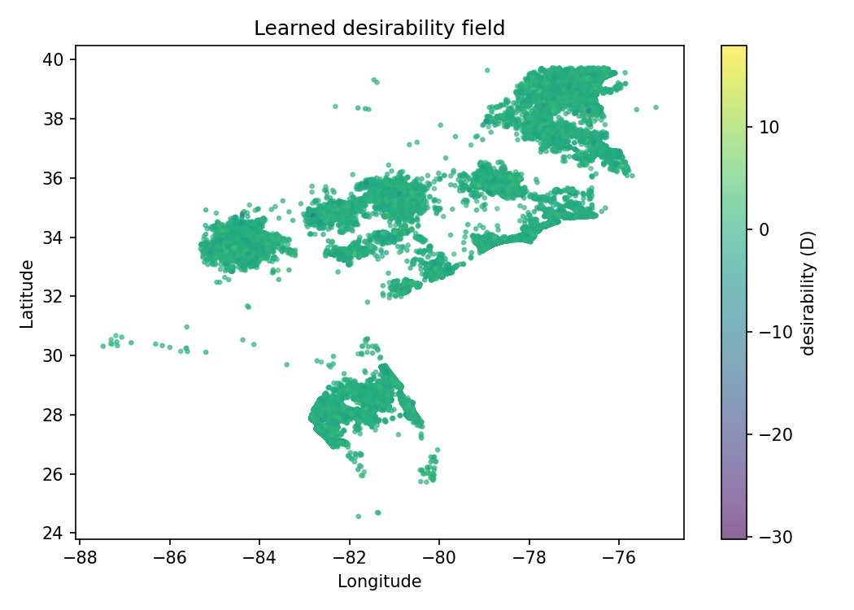
Desirability learned by Property engine

Slide 13
End-to-end system:
Market layer: The Market Engine produces probabilistic ZIP×Month indices 1–2 months ahead, with downside/upside bands for each geography.
Property layer: The Property Engine takes these market indices as context and adds home-specific intrinsic value and neighborhood desirability, producing a full price distribution for each address.
Decision layer: On top of these outputs we can build tools for land acquisition, release timing, list-price recommendations, and portfolio risk dashboards (e.g., which ZIPs or projects are over-exposed).
Feedback loop: As new transactions come in, the system re-trains both engines, tightening forecasts and updating neighborhood premiums in near real time.

Slide 14
Business View
Together, the two engines become a reusable “Neural estimate” platform for the builder: one model family owns market trajectory and risk, the other owns micro-location and product-level pricing, and both plug directly into existing budgeting, underwriting, and sales workflows.

Slide 15
Questions?

